Slide 1

ThE NEW RULES ON LAND USE AFTER SB 236
Prepared by Les Knapp, Associate Director , MACo and
Amanda Stakem Conn, Principal Counsel to MDP*
for the Maryland State Bar Association , 2012-05-11
*This is prepared for educational purposes and is not advice of the Attorney General’s Office

Slide 2
Major Planning Components of Bill
Major/Minor Subdivision Definitions
Definition of Tiers
Tier Development and Adoption
Tier Check by Maryland Department of the Environment (MDE)
Exemption Provisions
Grandfathering
Reporting Requirements

Slide 3
Major vs. Minor Definitions
Local Jurisdictions may adopt a definition of major and minor residential subdivisions for the purposes of the bill by Dec. 31, 2012.
New definitions of minor subdivisions may not exceed 7 new lots

Slide 4
Growth TIER ADOPTION PROCESS
Adoption of Growth Tiers by a local jurisdiction is optional
After December 31, 2012, a local jurisdiction that has not adopted Tiers cannot authorize major residential subdivisions served by septic systems, community sewerage systems, or shared systems. May only authorize residential minor subdivisions served by septic systems or a major or minor subdivision served by public sewer.
Tier adoption process and statutory criteria for the Tiers is located in Article 66B (and after Oct. 1, Title 1, Subtitle 5 of the Land Use Article). Tier development prohibitions and limits is located in § 9-206 of the Environment Article.
Four classes of Tiers (I-IV) that dictate whether residential development may occur on a public sewerage system or a septic system

Slide 5
Growth Tier Adoption Process
A local jurisdiction does not have to adopt all 4 Tiers. Counties must adopt Tiers I, III, and IV and may adopt Tier II. Municipalities must adopt Tier I and may adopt Tier II. If a local jurisdiction does not adopt all of the authorized Tiers, the local jurisdiction must document the reasons for not adopting a particular Tier.
Local jurisdictions may use their existing comprehensive plan and zoning ordinance to create the Tiers [Uncodified Section 4 of SB 236]
Before adopting the Tiers, a local jurisdiction may submit proposed Tiers to Maryland Department of Planning (MDP) for technical assistance, review, and comment
After adoption of the Tiers, a local jurisdiction shall provide a map and information to MDP demonstrating the location of the Tiers and existing or planned water and sewer services

Slide 6
GROWTH TIER ADOPTION PROCESS
MDP may comment on the Tiers adopted by a local jurisdiction. If MDP comments, then the local legislative body or planning board/commission must hold a public hearing and review the tiers based on the comments.
If the planning board/commission holds the hearing, it must recommend to the local legislative body whether the Tiers should be changed or remain as adopted.
The local jurisdiction is not bound to the recommendations of MDP

Slide 7
GROWTH TIER ADOPTION PROCESS
A local jurisdiction that adopts the Tiers must incorporate the Tiers into its local comprehensive plan or an element of the plan when the local jurisdiction conducts its 6-year review of the plan.
A local jurisdiction may adopt the Tiers as an amendment to its comprehensive plan and may include the Tiers as an appendix that delineates the Tiers and the comprehensive plan land use categories and zoning ordinance districts that are included in each Tier. [Uncodified Section 4 of SB 236]

Slide 8
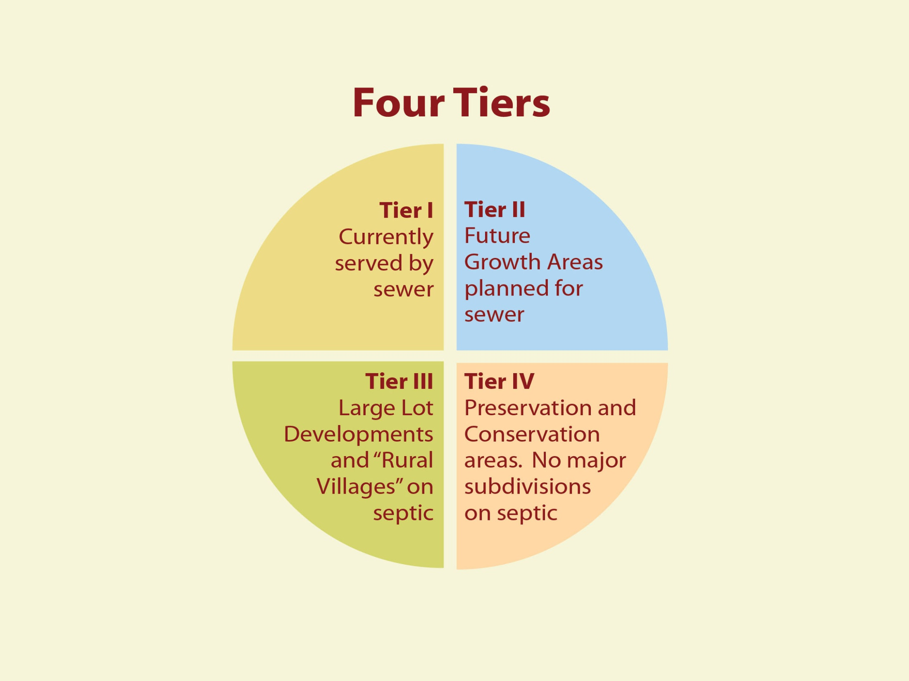

Slide 9
TIER I Criteria
A Tier I area must:
(1) be a mapped locally designated growth area served by public sewerage
OR
(2) a municipal corporation that is a priority funding area (PFA) and served by public sewerage

Slide 10
TIER I Development Restrictions
Tier I allows:
(1) major and minor subdivisions on public sewerage

Slide 11
TIER II CRiteria
A Tier II area must:
(1) be planned to be served by a public sewerage in a municipal growth element or a mapped locally designated growth area
AND
(2) be needed to satisfy the demand for development at densities consistent with the jurisdiction’s long-term development policy after considering the capacity of land areas available for development, including in-fill and redevelopment

Slide 12
TIER II Development Restrictions
Tier II allows:
(1) major or minor subdivisions on public sewerage systems
(2) minor subdivisions on septic systems

Slide 13
TIER III Criteria
A Tier III area must:
(1) not be planned for sewerage service
(2) not be dominated by agricultural or forest land
(3) not be planned or zoned by a local government for land, agricultural, or resource protection
AND
(4) fall in one of the following categories
a municipal corporation not served by public sewerage
a rural village as defined by statute (§ 5-7B-03(f) of the State Finance and Procurement Article)
an area planned or zoned for large lot development
a mapped locally designated growth area
NOTE: A local jurisdiction must strive to avoid creating a Tier III area that is bounded on all sides by land in a Tier IV area.

Slide 14
TIER III Development Restrictions
Tier III allows:
(1) minor subdivisions on septic systems
(2) major subdivisions on septic systems, community systems, or shared facilities if the local planning board has reviewed and recommended the approval of the major subdivision
NOTE: Before approving a Tier III major subdivision the planning board must hold at least one public hearing and include as part of its review: (1) the cost of providing local government services to the subdivision (unless such review is already required); and (2) the potential environmental issues or a natural resources inventory related to the proposed subdivision)

Slide 15
TIER IV CRITERIA
A Tier IV areas cannot be planned for sewerage service and are:
(1) areas planned or zoned by a local jurisdiction for land, agricultural, or resource protection, preservation, or conservation
(2) areas dominated by agricultural lands, forest lands, or other natural areas
OR
(3) Rural Legacy areas, priority preservation areas, or areas subject to a State or local covenant, restriction, condition, or conservation easement for the purposes of natural resources or agricultural land preservation

Slide 16
TIER IV Development Restrictions
Tier IV allows:
(1) minor subdivisions on septic systems
(2) IF the jurisdiction’s Tier IV area has been verified by MDP as having an actual overall yield of not more than one dwelling unit per 20 acres, major subdivisions on septic systems, community systems, or shared facilities at the local jurisdiction’s discretion

Slide 17
TIER IV 1 in 20 Exception
For exception to apply, a local jurisdiction may request that MDP verify that the jurisdiction’s subdivision and zoning requirements in the jurisdiction’s cumulative Tier IV area result in an actual overall yield of not more than one dwelling unit per 20 acres
If requested by a local jurisdiction to verify, MDP shall:
(1) review the local zoning code and any relevant subdivision or development regulations or rules to help determine the overall development yield;
(2) request, if appropriate, information from the local jurisdiction to help determine the overall development yield in Tier IV;
(3) examine any additional information that the local jurisdiction provides supporting the qualification of the jurisdiction’s zoning districts;
(4) consult with the Maryland Sustainable Growth Commission; and
(5) discuss any discrepancies or questions with the local jurisdiction before making a final determination
[§ 9-206(h) of the Environment Article and Uncodified Section 5 of SB 236]

Slide 18
TIER Designation conflicts
If two or more local jurisdictions adopt conflicting Tier designations for the same area, the Department of the Environment (MDE) and MDP shall confer with the local jurisdictions to seek resolution.
If the conflict is not resolved, MDE shall determine which Tier designation prevails
MDP shall recommend to MDE a preferred Tier designation based on:
(1) The local jurisdictions’ comprehensive plans, including applicable municipal growth elements, water resource elements, land use elements, and priority preservation elements;
(2) Growth projections and development capacity; AND
(3) Availability of infrastructure
MDE may accept MDP’s recommendation or substitute its own decision when making a decision on which Tier designation prevails

Slide 19
Resubdivision Restrictions
Bill contains provisions that prevent land from being subdivided into minor subdivisions on septics overtime if the land is located in a Tier that is restricted to minor subdivisions on septic
Exceptions to the resubdivision restriction:
Subdividing into one subdivision over time is allowed; and
When land becomes a PFA that is to be served by public sewer

Slide 20
Bill Application to Projects in Process
July 1, 2012 effective date
Final plat approval by December 31, 2012 – Limitations on wastewater disposal systems do not apply
No final plat approval by December 31, 2012:
(1) Do grandfather provisions apply; or
(2) If not, limitations on wastewater disposal systems apply

Slide 21
MDP Reporting Requirements
On or before February 1st, 2013 MDP, in consultation with MDE, shall report on:
adoption of the tiers by each local jurisdiction
adoption or alteration of local ordinances or regs to implement the Act
list of comments that MDP provided to each jurisdiction

Slide 22
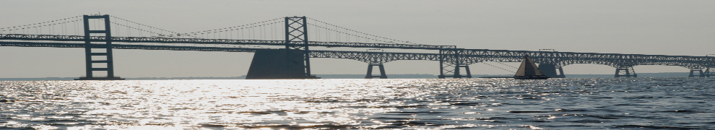
Key Milestones/Dates of Interest
MDP Planning Directors Meeting
Recommended date
for Tier Adoption
Public hearings
on MDP comments
5/24/12
7/1/12
10/1/12
12/31/12
2012-2013
Feb 2013
Effective Date of Bill
If no tiers adopted, restrictions on major subdivisions in place;
- adopt new definition of subdivision
MDP report due
to General Assembly

Slide 23
IMPACT OF SB 236 on Local land Use
Impact will vary based on local jurisdiction
Little impact for municipalities and Baltimore City
Moderate impact on urban counties and counties close to their build-out capacity
Significant impact on some rural counties

Slide 24

Factors to consider as SB 236 moves forward
Local government responsibility
Flexibility in Tier designation
Growth in rural areas
SB 236 does not exist in a vacuum

Slide 25
Recent Land Use and Environmental Initiatives
2006 New water resources element, municipal growth element, and priority preservation element [HB 1141 and HB 2]
2007 New stormwater management requirements [HB 786/SB 784]
2008 New critical area requirements [HB 1253]
2009 New planning visions, Smart Growth measures and indicators, and plan consistency requirements [HB 294/SB 273, HB 295/SB 276, and HB 297/SB 280]
2010 New transportation planning requirements [HB 1155]
2011 PlanMaryland [Executive Order 01.01.2011.22]
2012 New Growth Tiers and septic system restrictions [SB 236]
The Present – Chesapeake Bay Total Maximum Daily Load requirements
The Future – Greenhouse gas reduction initiatives

Slide 26
CONCLUSION
SB 236 has “teeth” and will limit future development on septic systems
Local governments are expected to designate Tiers responsibly but also should be afforded a level of flexibility when designating the Tiers.*
Effect of SB 236 is further magnified when considered as part of cumulative package of recent land use and environmental initiatives
As land use and environmental laws and regulations become increasingly complex, Maryland land use attorneys will not suffer a shortage of work ☺
*Amanda Conn notes that the Tiers must meet the requirements of Article 66B.

Slide 27
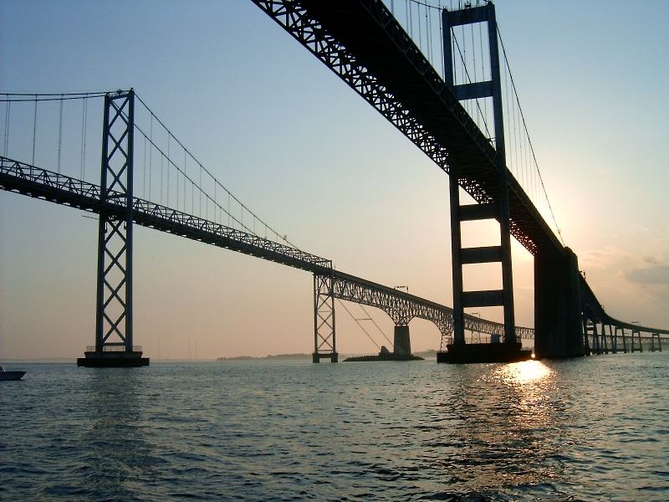
QUESTIONS???

